Slide 1
White Box Testing

Slide 2
CYCLOMATIC COMPLEXITY
Cyclomatic complexity is a software metric that provides a quantitative measure of the logical complexity of a program.
Cyclomatic complexity defines number of independent paths which can be further used in development of test cases.

Slide 3
Complexity is computed in one of three ways:
1. The number of regions of the flow graph corresponds to the cyclomatic complexity.
2. Cyclomatic complexity V(G) for a flow graph G is defined as
V(G) = E - N + 2(McCabe Complexity Measure)
where E is the number of flow graph edges and N is the number of flow graph nodes.
3. Cyclomatic complexity V(G) for a flow graph G is also defined as
V(G) = P + 1
where P is the number of predicate nodes contained in the flow graph G.

Slide 4
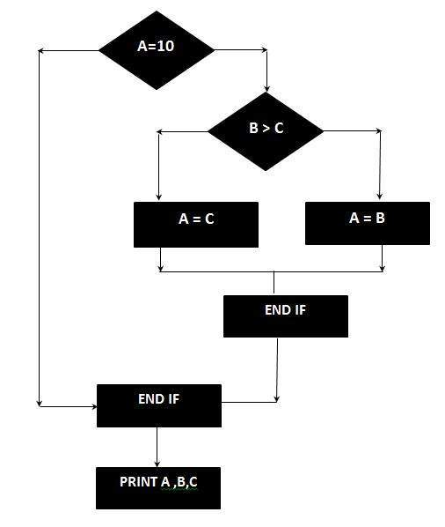
IF A = 10 THEN
IF B > C THEN
A = B
ELSE
A = C
ENDIF
ENDIF
Print A
Print B
Print C

Slide 5
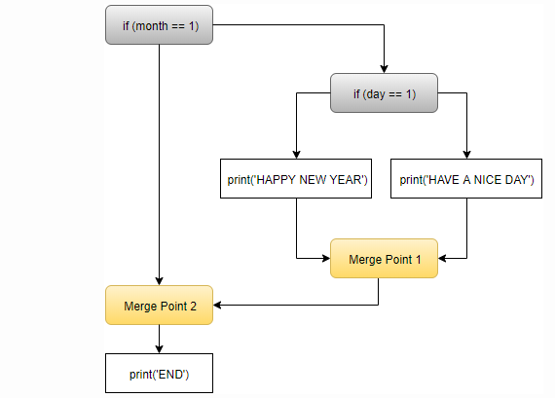
if (month == 1)
{
if (day == 1)
{
print('HAPPY NEW YEAR');
}
else
{
print('HAVE A NICE DAY');
}
}
print('END');

Slide 6
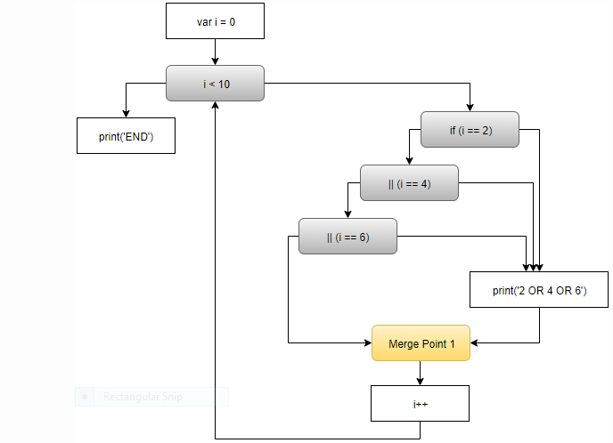
for (var i = 0; i < 10; i++)
{
if (i == 2 || i == 4 || i == 6)
{
print('2 OR 4 OR 6');
}
}
print('END');

Slide 7
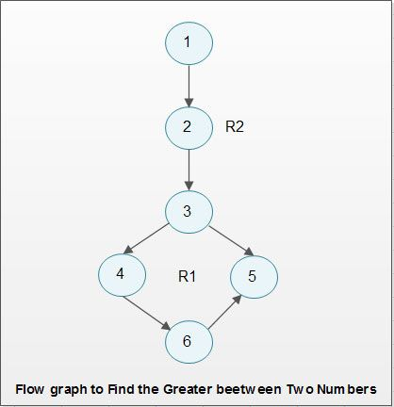
procedure greater;
integer: x, y, z = 0;
enter the value of x;
enter the value of y;
if x > y then
z = x;
else
z = y;
end greater

Slide 8
Determine all independent paths through the program
For the flow graph depicted the independent paths are listed below.
P1: 1-2-3-4-6
P2: 1-2-3-5-6

Slide 9
Compute the cyclomatic complexity
CC = 2 as there two regions R1 and R2
or
CC 6 edges - 6 nodes + 2 =2
or
CC 1 predicate node + 1 = 2.

